Slide 1
Recap lecture 35
Regular grammar, null productions and examples, nullable productions and examples, unit productions and example, Chomsky Normal Form (Definition)

Slide 2
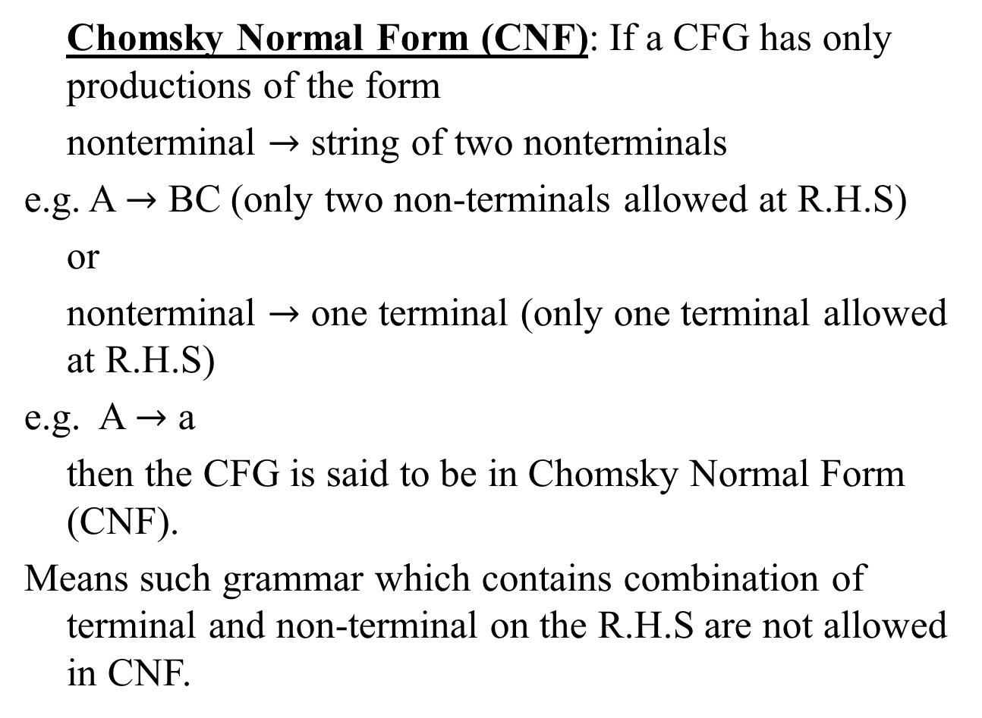
Chomsky Normal Form
Chomsky Normal Form (CNF): If a CFG has only productions of the form
nonterminal $→$ string of two nonterminals
e.g. A $→$ BC (only two non-terminals allowed at R.H.S)
or
nonterminal $→$ one terminal (only one terminal allowed at R.H.S)
e.g. A $→$ a
then the CFG is said to be in Chomsky Normal Form (CNF).
Means such grammar which contains combination of terminal and non-terminal on the R.H.S are not allowed in CNF.

Slide 3
Chomsky Normal Form
Advantages:
Length of each production is restricted
Derivation tree or parse tree obtained from CNF is always Binary Tree
The no. of steps required to derive a string of length |W| is (2|W|-1)

Slide 4
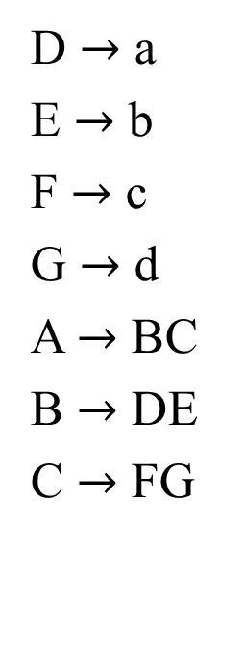
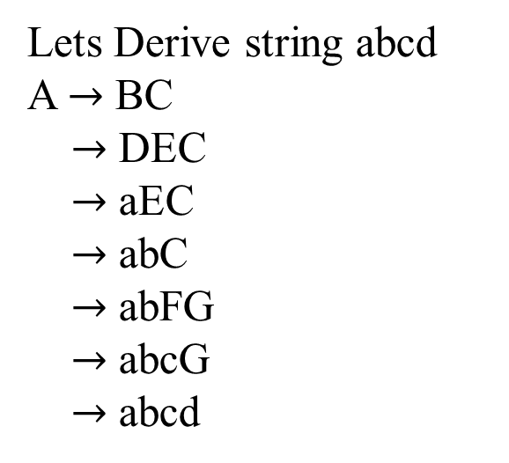
Example: Chomsky Normal Form
D $→$ a
E $→$ b
F $→$ c
G $→$ d
A $→$ BC
B $→$ DE
C $→$ FG
Lets Derive string abcd
A $→$ BC
$→$ DEC
$→$ aEC
$→$ abC
$→$ abFG
$→$ abcG
$→$ abcd
Derive string abcd
Third point from the
Advantage:
|w| = 2|w| -1
= 2*4 – 1
= 8 – 1
= 7

Slide 5
Note
It is to be noted that any CFG can be converted to be in CNF, if the null productions and unit productions are removed. Also if a CFG contains nullable productions as well, then the corresponding new production are also to be added. Which leads the following theorem

Slide 6
Theorem
All NONNULL words of the CFL can be generated by the corresponding CFG which is in CNF i.e. the grammar in CNF will generate the same language except the null string.
Following is an example showing that a CFG in CNF generates all nonnull words of corresponding CFL.

Slide 7
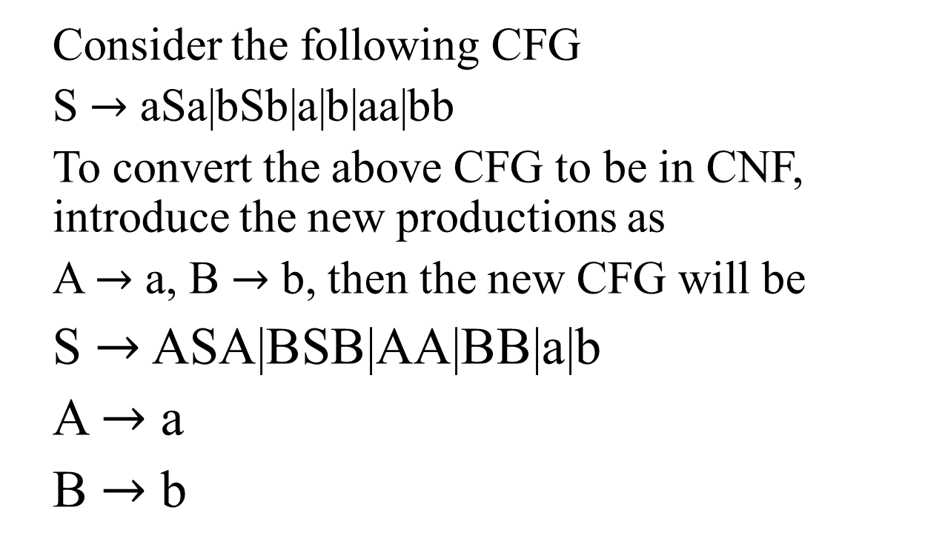
Example
Consider the following CFG
S $→$ aSa|bSb|a|b|aa|bb
To convert the above CFG to be in CNF, introduce the new productions as
A $→$ a, B $→$ b, then the new CFG will be
S $→$ ASA|BSB|AA|BB|a|b
A $→$ a
B $→$ b

Slide 8
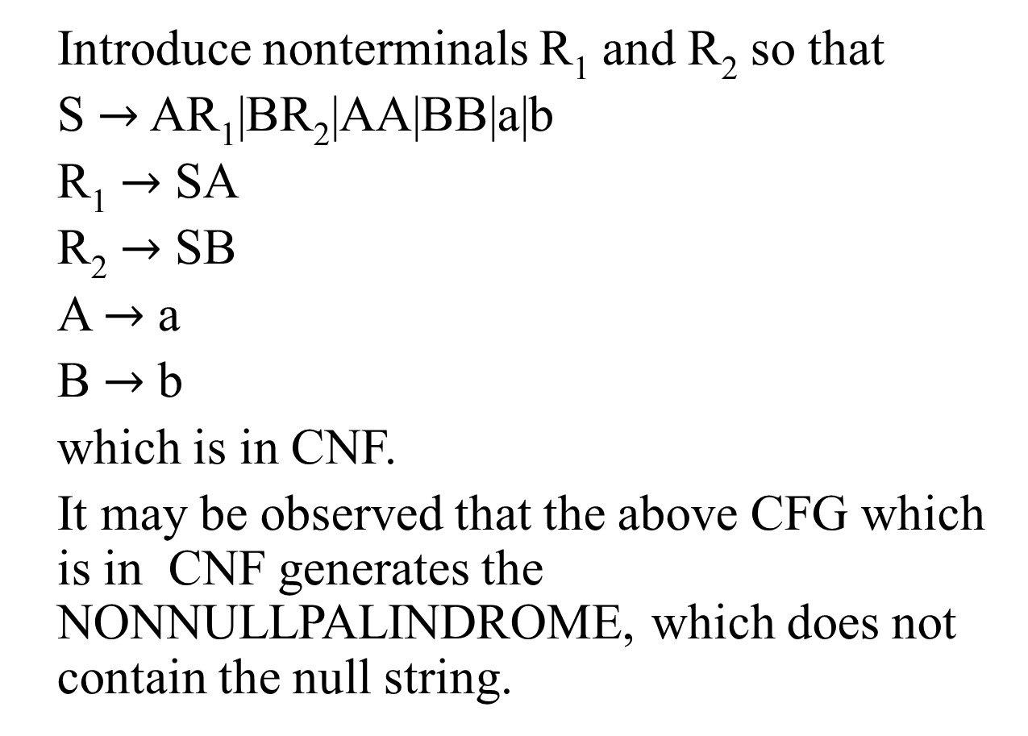
Example continued …
Introduce nonterminals R₁ and R₂ so that
S $→$ AR₁|BR₂|AA|BB|a|b
R₁ $→$ SA
R₂ $→$ SB
A $→$ a
B $→$ b
which is in CNF.
It may be observed that the above CFG which is in CNF generates the NONNULLPALINDROME, which does not contain the null string.

Slide 9
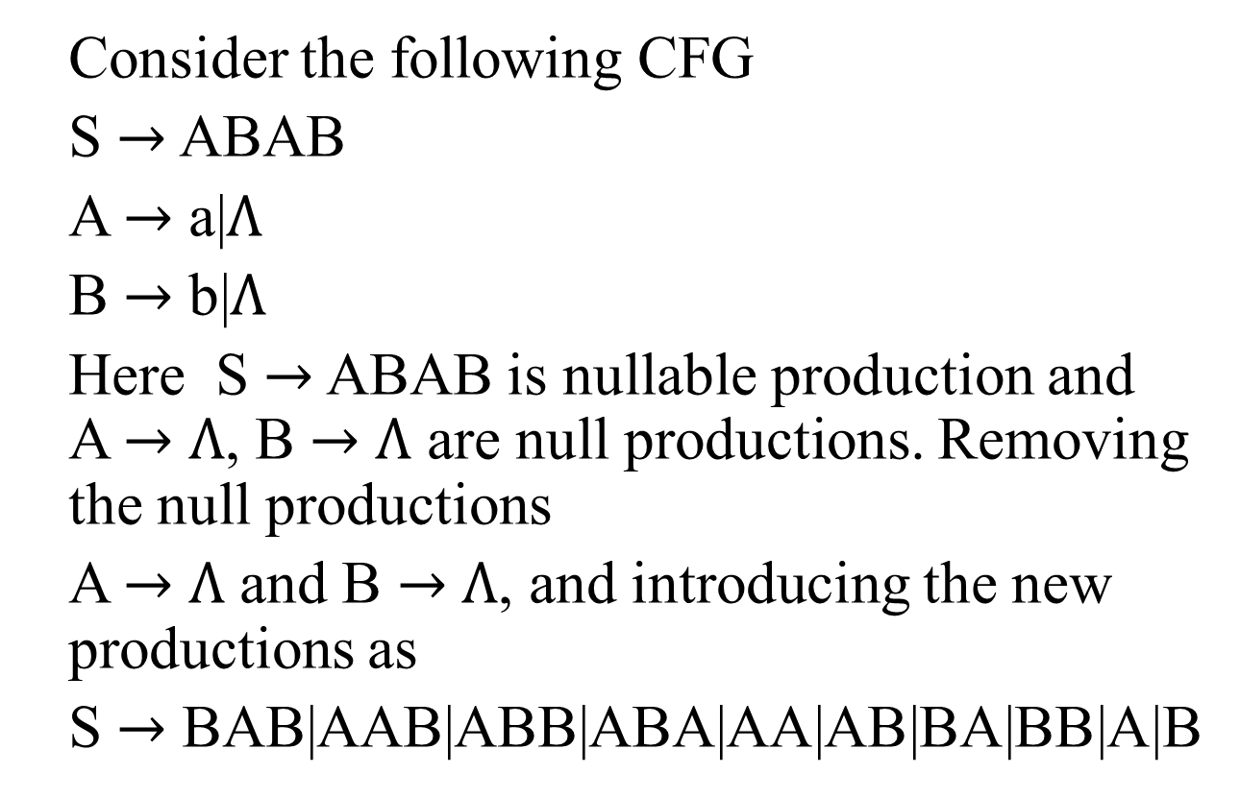
Example
Consider the following CFG
S $→$ ABAB
A $→$ a|$Λ$
B $→$ b|$Λ$
Here S $→$ ABAB is nullable production and A $→$ $Λ$, B $→$ $Λ$ are null productions. Removing the null productions
A $→$ $Λ$ and B $→$ $Λ$, and introducing the new productions as
S $→$ BAB|AAB|ABB|ABA|AA|AB|BA|BB|A|B

Slide 10
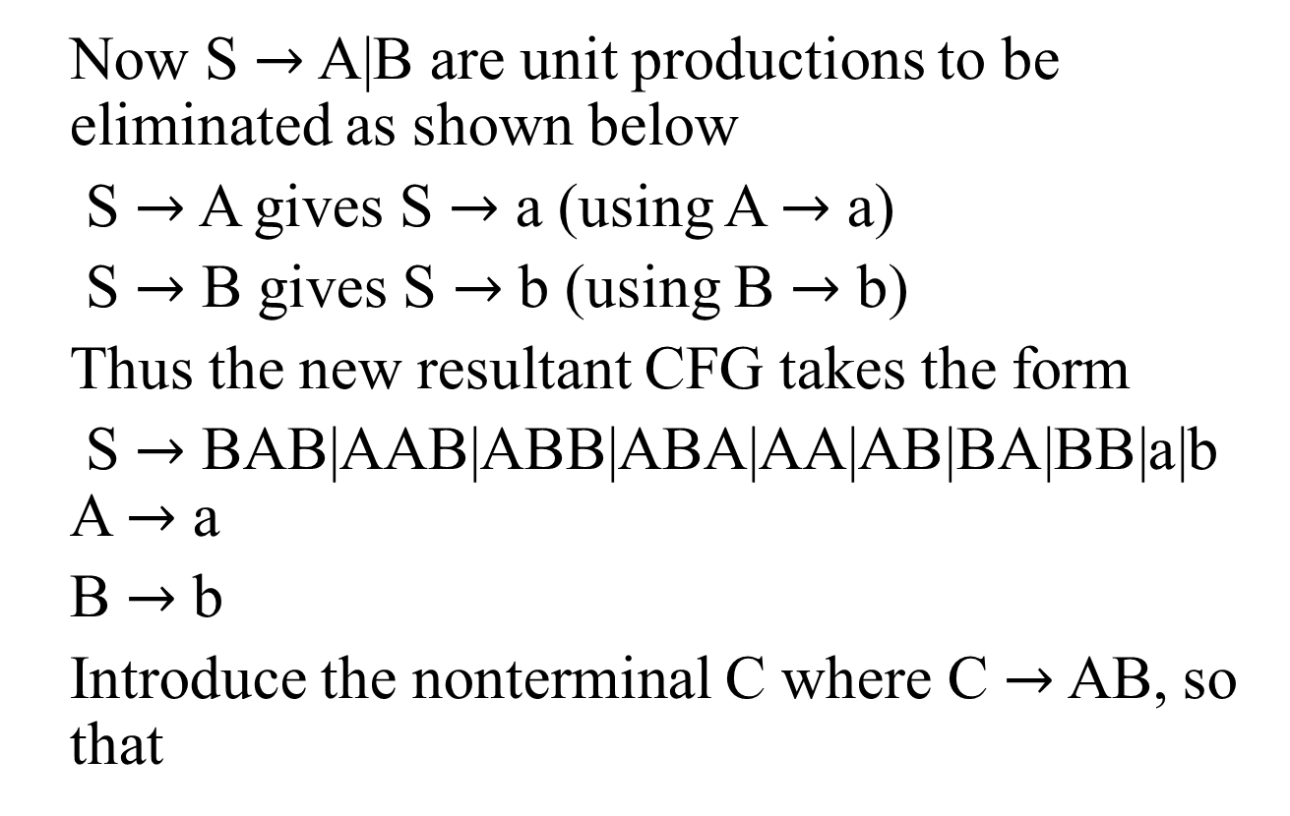
Example continued …
Now S $→$ A|B are unit productions to be eliminated as shown below
S $→$ A gives S $→$ a (using A $→$ a)
S $→$ B gives S $→$ b (using B $→$ b)
Thus the new resultant CFG takes the form
S $→$ BAB|AAB|ABB|ABA|AA|AB|BA|BB|a|b A $→$ a
B $→$ b
Introduce the nonterminal C where C $→$ AB, so that

Slide 11
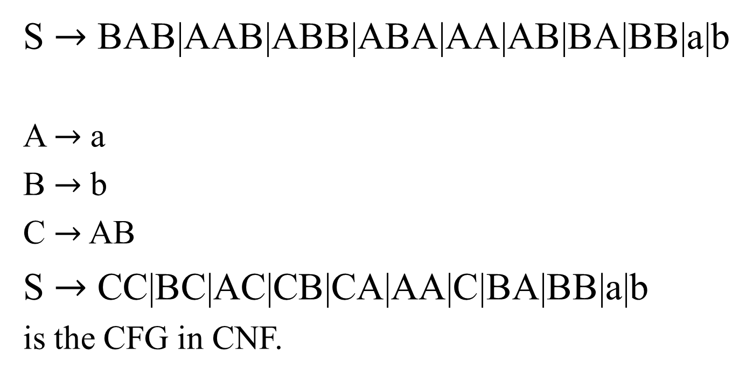
Example continued …
S $→$ BAB|AAB|ABB|ABA|AA|AB|BA|BB|a|b
A $→$ a
B $→$ b
C $→$ AB
S $→$ CC|BC|AC|CB|CA|AA|C|BA|BB|a|b
is the CFG in CNF.

Slide 12

Task
Convert the following CFG to be in CNF
S $→$ ABAB
A $→$ a|$Λ$
B $→$ b|$Λ$

Slide 13
Left most derivation
Definition: The derivation of a word w, generated by a CFG, such that at each step, a production is applied to the left most nonterminal in the working string, is said to be left most derivation.
It is to be noted that the nonterminal that occurs first from the left in the working string, is said to be left most nonterminal. Following is an example

Slide 14
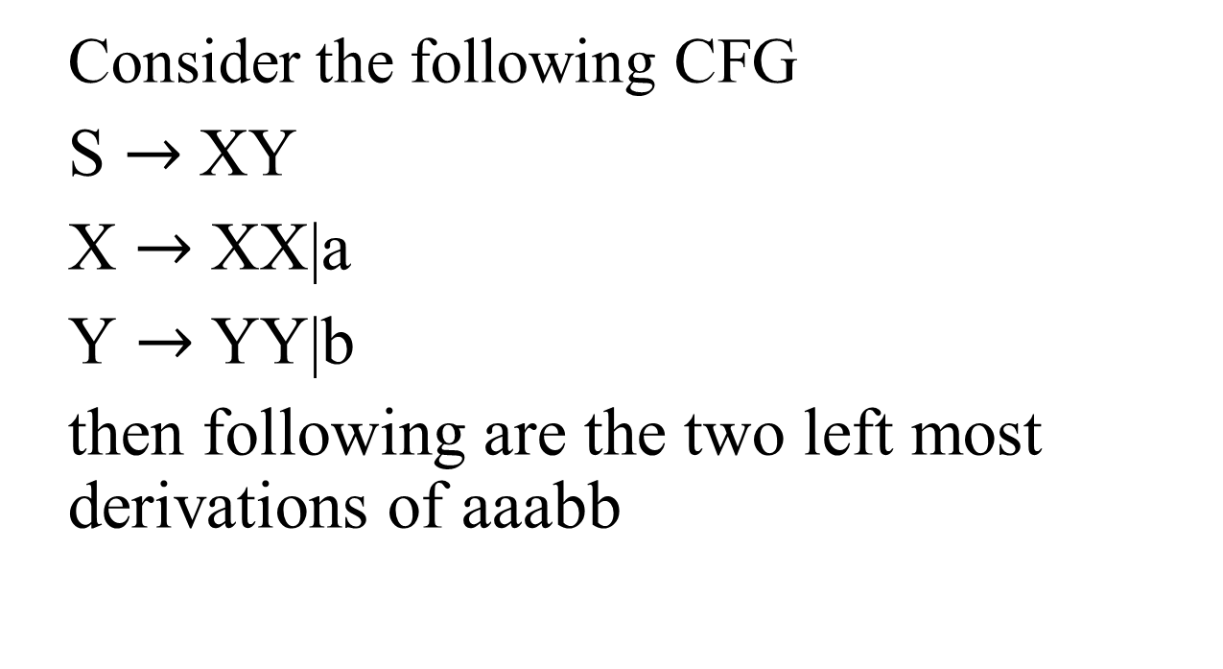
Example
Consider the following CFG
S $→$XY
X $→$ XX|a
Y $→$YY|b
then following are the two left most derivations of aaabb

Slide 15
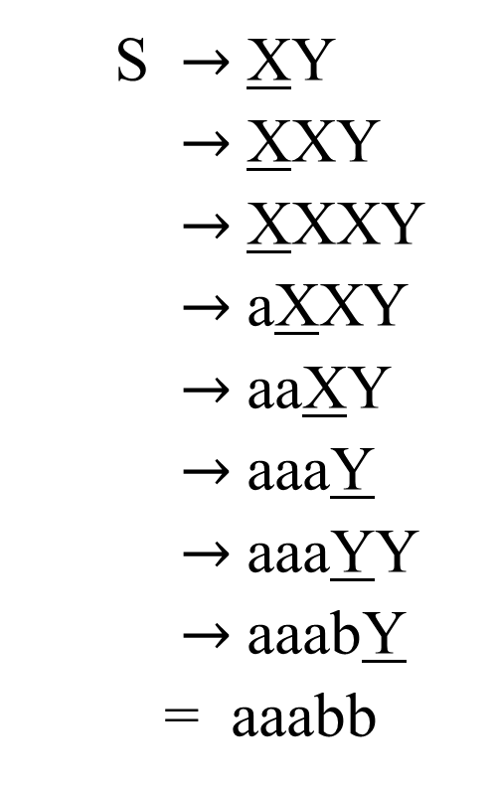
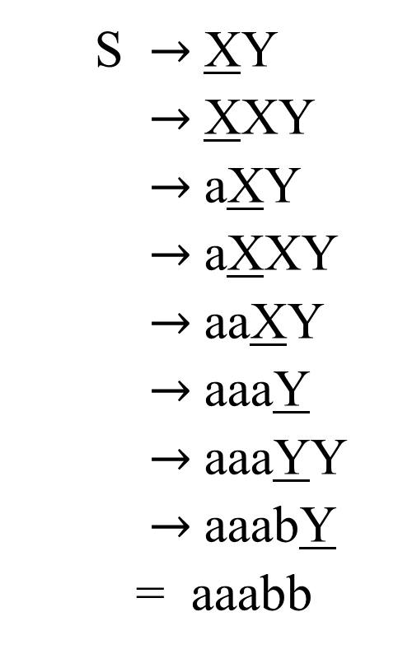
Example continued …
S $→$ XY
$→$ XXY
$→$ aXY
$→$ aXXY
$→$ aaXY
$→$ aaaY
$→$ aaaYY
$→$ aaabY
= aaabb
S $→$ XY
$→$ XXY
$→$ XXXY
$→$ aXXY
$→$ aaXY
$→$ aaaY
$→$ aaaYY
$→$ aaabY
= aaabb

Slide 16
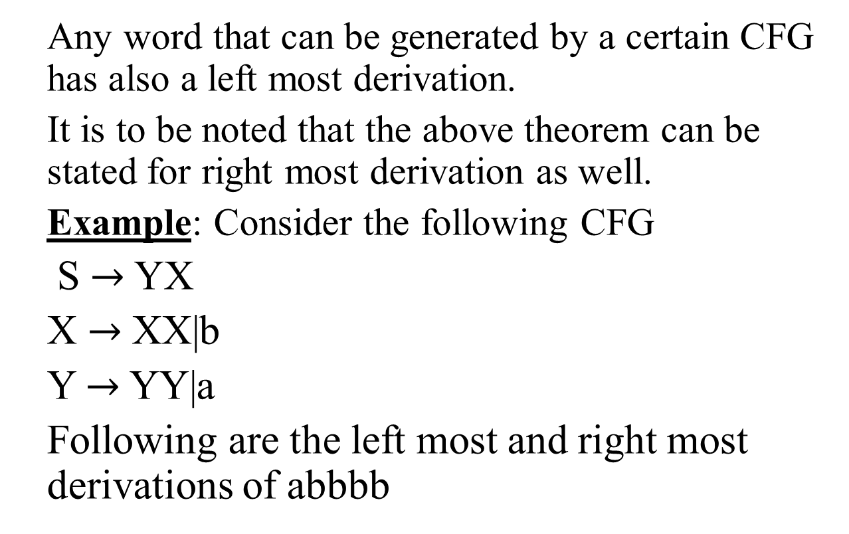
Theorem
Any word that can be generated by a certain CFG has also a left most derivation.
It is to be noted that the above theorem can be stated for right most derivation as well.
Example: Consider the following CFG
S $→$YX
X $→$ XX|b
Y $→$YY|a
Following are the left most and right most derivations of abbbb

Slide 17
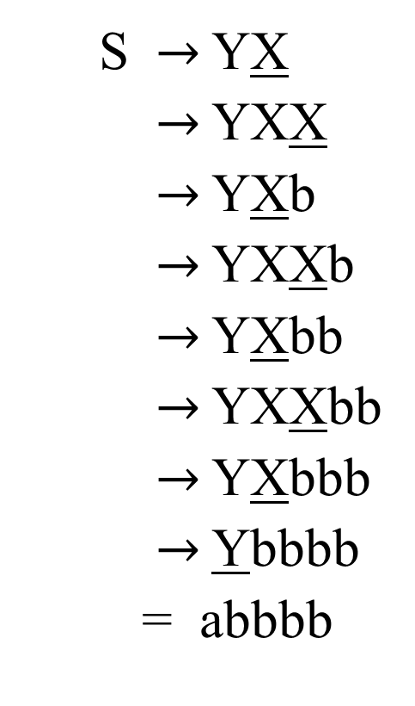
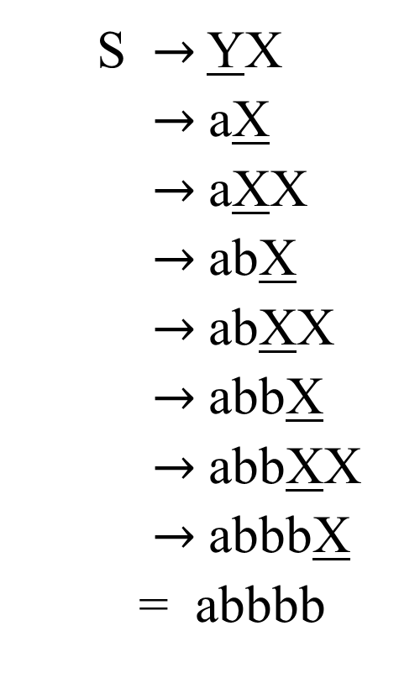
Example continued …
S $→$ YX
$→$ aX
$→$ aXX
$→$ abX
$→$ abXX
$→$ abbX
$→$ abbXX
$→$ abbbX
= abbbb
S $→$ YX
$→$ YXX
$→$ YXb
$→$ YXXb
$→$ YXbb
$→$ YXXbb
$→$ YXbbb
$→$ Ybbbb
= abbbb

Slide 18
Summing Up
Chomsky Normal Form, Theorem regarding CNF, examples of converting CFG to be in CNF, Left most and Right most

